Slide 1
Efficiency-Driven Machine Learning Models for Credit Card Fraud Detection: A Comparative Study and Optimization Approach
1
Presented by- Team 27
Members:
Sumit Haldar (20101544)
Maisha Shabnam Chowdhury (20101459)
Nazifa Bushra (20101536)

Slide 2
Outline
2
Abstract
Introduction
Literature Review
Dataset
Methodology
-XGBoost
-Logistic Regression
-LightGBM
- K-Nearest Neighbors (KNN):
-Isolation Forest
-Local Outlier Factor
Result Analysis
Future Works
Limitations
Conclusion
References

Slide 3

ABSTRACT
3
In response to the critical threat posed by credit card fraud, this paper conducts a thorough investigation into the efficiency of machine learning models for fraud detection. Focusing on various deep learning architectures, the study compares different classification models and hybrid approaches to identify the most effective ones. By addressing challenges such as uneven class distribution, interpretability, and computing capacity, the research aims to optimize the performance of these models. Utilizing a comprehensive dataset, including both legitimate and fraudulent transactions, allows for a realistic evaluation of model effectiveness. The findings underscore the importance of precise fraud detection systems in the dynamic landscape of financial security, emphasizing the practical implications of the study's outcomes.

Slide 4
INTRODUCTION
4
The rise of digital transactions brought unprecedented convenience globally, with credit cards serving as the linchpin for swift and efficient financial interactions. However, this surge in digital transactions has given way to a parallel escalation in credit card fraud. Traditional fraud detection methods struggle to keep up with the increasingly sophisticated nature of these fraudulent activities.Credit card fraud is a pervasive global problem affecting nations worldwide, exemplified by the Republic of Korea's experience. Data from the Federal Trade Commission (FTC) reveals alarming statistics, with 1579 data breaches and 179 million compromised data points, predominantly due to credit card fraud.
In response to this challenge, our study focuses on innovative approaches to credit card fraud detection. We conduct a detailed analysis of advanced machine learning architectures, particularly emphasizing anomaly detection techniques like XGBoost, Logistic Regression, LightGBM, K-Nearest Neighbors (KNeighborsClassifier). This research aims not only to strengthen security mechanisms but also to enhance effectiveness, flexibility, and practicality in combating credit card fraud.In the ever-evolving landscape of financial security, our work charts a course where innovation meets necessity.

Slide 5
LITERATURE REVIEW
5
Authors: Emmanuel Ileberi, Yanxia Sun & Zenghui Wang [1] -Introduced credit card fraud detection using Decision Tree, Random Forest, Logistic Regression, Artificial Neural Network, and Naive Bayes. Proposed a strategy with Genetic Algorithm for feature selection, achieving 99.98% accuracy for GA-RF.
Authors: Shanshan Jiang, Ruiting Dong, Jie Wang, and Min Xia [2]- Addressed credit card fraud in the internet age. Presented UAAD-FDNet, a framework using autoencoders, feature attention, and GANs for Unsupervised Attentional Anomaly Detection. Demonstrated superior fraud detection performance on relevant datasets.
Authors: Jiwon Chung and Kyungho Lee [3]- Explored fraudulent credit card transactions in the growing commerce landscape and IoT devices. Combined K-nearest neighbor, linear discriminant analysis, and linear regression, showing significant progress in fraud detection. Emphasized the urgency of the matter due to the alarming rise in credit card fraud incidents.
Authors: Noor Saleh Alfaiz and Suliman Mohamed Fati [4]- Investigated credit card fraud during the COVID-19 epidemic. Tested 66 machine learning models, with AllKNN-CatBoost outperforming others. Addressed imbalanced datasets with efficient machine learning algorithms and resampling strategies.

Slide 6
6
Authors: J Femila Roseline, GBSR Naidu, Dr. V. Samuthira Pandi, S Alamelu alias Rajasree, and Dr.N. Mageswari [5]-Discussed credit card fraud due to increased card use and technology advancements. Proposed an efficient fraud detection system using Long Short-Term Memory-Recurrent Neural Network (LSTM RNN) with an attention mechanism. Highlighted the effectiveness of machine learning, particularly LSTM-RNN, in pattern detection.
Authors: Fahdah A. Almarshad, Ghada Abdalaziz Gashgari, and Abdullah I. A. Alzahrani [6]-Explored credit card fraud in the digital age and emphasized the need for sophisticated fraud detection techniques. Introduced a unique method using Generative Adversarial Networks (GANs) to address dataset imbalance. Emphasized the model's efficacy in terms of resilience, reduced false positives, and increased efficiency.
Authors: Zainab Firdous, Sushma, Aftab Pasha, M Shahista Banu, and Najmusher [7]- Conducted a thorough comparison of classification models (Logistic Regression, Support Vector Machine, Random Forest) for credit card fraud detection. Utilized the UCI machine learning repository and visualized data using MATPLOTLIB and seaborn libraries. Concluded that both Support Vector Machine and Random Forest have good accuracy compared to Logistic Regression.
Authors: Varun Kumar, Vijaya Kumar, Vijaya Shankar, Pratibha K [8]-Built a model predicting fraud and non-fraud transactions using machine learning algorithms. Analyzed time and transaction amount with classification models and linear algebra. Concluded that Artificial Neural Network (ANN) had the highest accuracy among the models.
Authors: Priti Jadhav, Rutuja Ghadge, Utkarsha Halpatrao, Prof. Vilas Jadhav [9]-Modeled a dataset for credit card fraud detection using machine learning algorithms, including Artificial Neural Networks, Gradient Boosting Algorithms, Logistic Regression, and Decision Tree. Concluded that the gradient boosting model demonstrated higher accuracy than other machine learning models.

Slide 7
DATASET
7
The dataset encompasses 284,807 transactions from European card owners, revealing a mere 492 instances of fraud. This significant imbalance, where fraud cases are markedly fewer than normal transactions, poses challenges for machine learning model training. The dataset undergoes PCA transformation, converting features V1 to V28 into PCA values while retaining time and amount as unaltered numeric values. Privacy concerns are addressed by presenting many values as PCA representations.
However, the class imbalance necessitates careful consideration during model development to avoid bias toward the majority class (normal transactions). Striking a balance in the learning process ensures that the model accurately identifies both normal and fraudulent transactions, enhancing its overall performance and mitigating the risk of misclassifications.

Slide 8
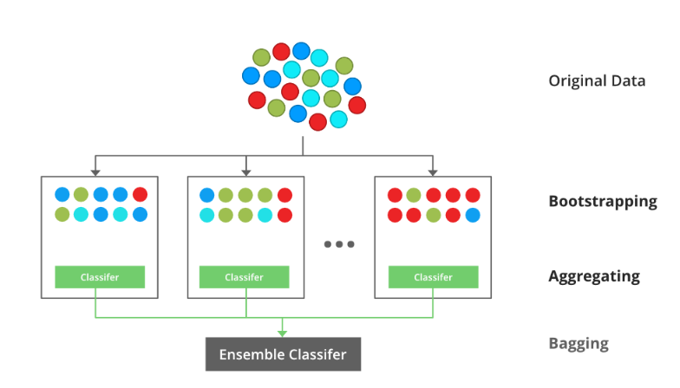
METHODOLOGY
8
To comprehend the credit card fraud detection problem, we begin with visualization and statistical analysis to assess data imbalance. Oversampling, scaling, standardization, and normalization techniques are employed for data balancing. Numpy, Matplotlib, and Seaborn libraries facilitate ML model execution and dataset visualization.
XGBoost:
XGBoost, a collaborative learning method, is chosen for its ability to handle intricate data relationships. By combining predictions from weak models, it provides a reliable and accurate final forecast. With its proven effectiveness in various machine learning contests, XGBoost is particularly well-suited for detecting complex and dynamic patterns in credit card fraud.

Slide 9
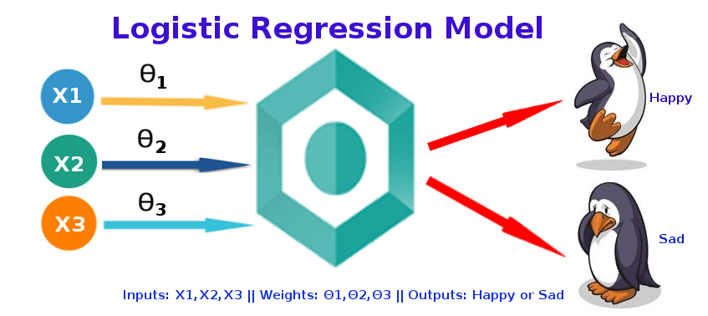
Logistic Regression:
Logistic Regression, despite its name, is vital for binary classification. Transforming input data into probabilities through the logistic function, it offers simplicity and interpretability. Logistic Regression serves as a baseline model, aiding in understanding linear relationships within the data and providing insights for more complex models.
9

Slide 10
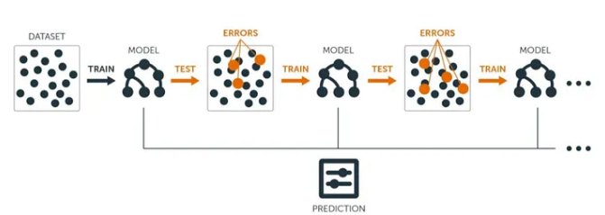
LightGBM:
LightGBM, a gradient boosting framework, prioritizes efficiency and speed. Utilizing 'Gradient-based One-Side Sampling,' it excels in training on large datasets and handling categorical features. With a balance between accuracy and computational efficiency, LightGBM is well-suited for credit card fraud detection, especially in real-time processing scenarios.
10

Slide 11
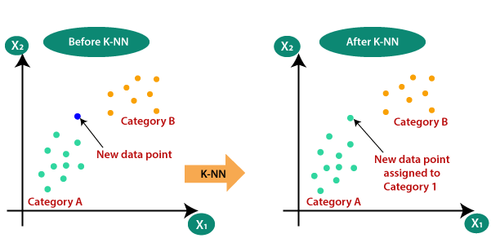
11
K-Nearest Neighbors (KNN):
K-Nearest Neighbors, a simple yet effective method, categorizes instances based on the majority class of their nearest neighbors. Its proximity-based prediction offers insights into instances with similar attributes belonging to the same class. KNN provides a counterpoint to more complex models, shedding light on the role of proximity in fraud detection.

Slide 12
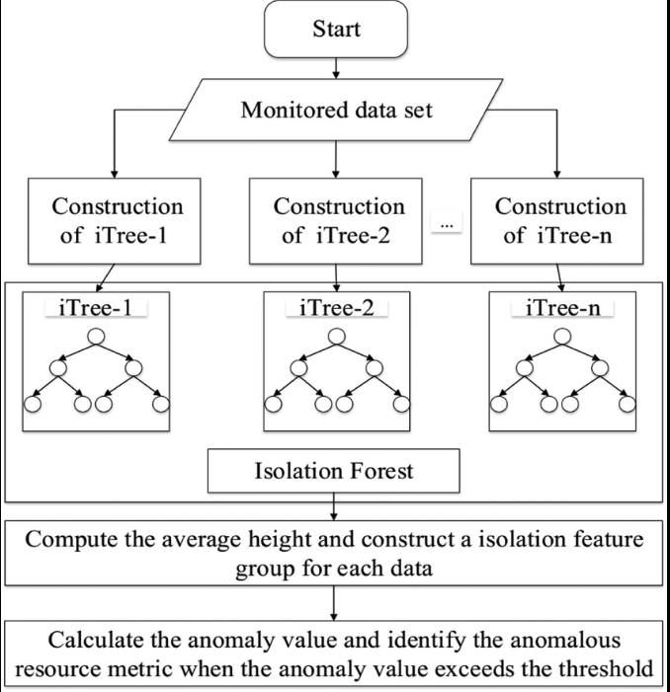
12
Isolation Forest:
Isolation Forest isolates anomalies by building random decision trees, making it highly effective in outlier detection. Its ability to swiftly identify irregularities aligns with the dynamic nature of credit card fraud patterns. The anomaly score formulation reflects the mathematical elegance of its efficient anomaly isolation capabilities.

Slide 13
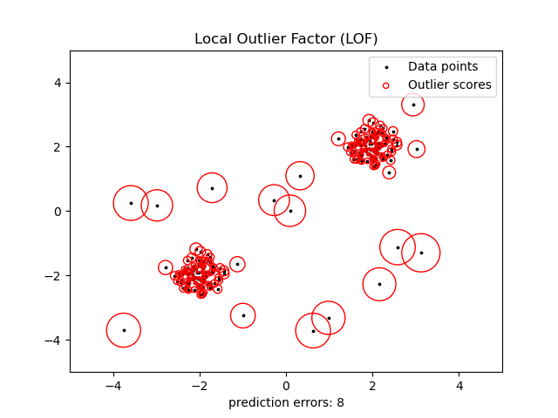
Local Outlier Factor (LOF):
LOF employs data point density fluctuations to assign anomaly scores, excelling in identifying subtle variations indicative of fraudulent activity. Beyond anomaly detection, LOF demonstrates a profound understanding of local patterns. LOF's adaptability to local data density enhances fraud detection by capturing nuanced patterns, contributing to a comprehensive and adaptive system.
13

Slide 14
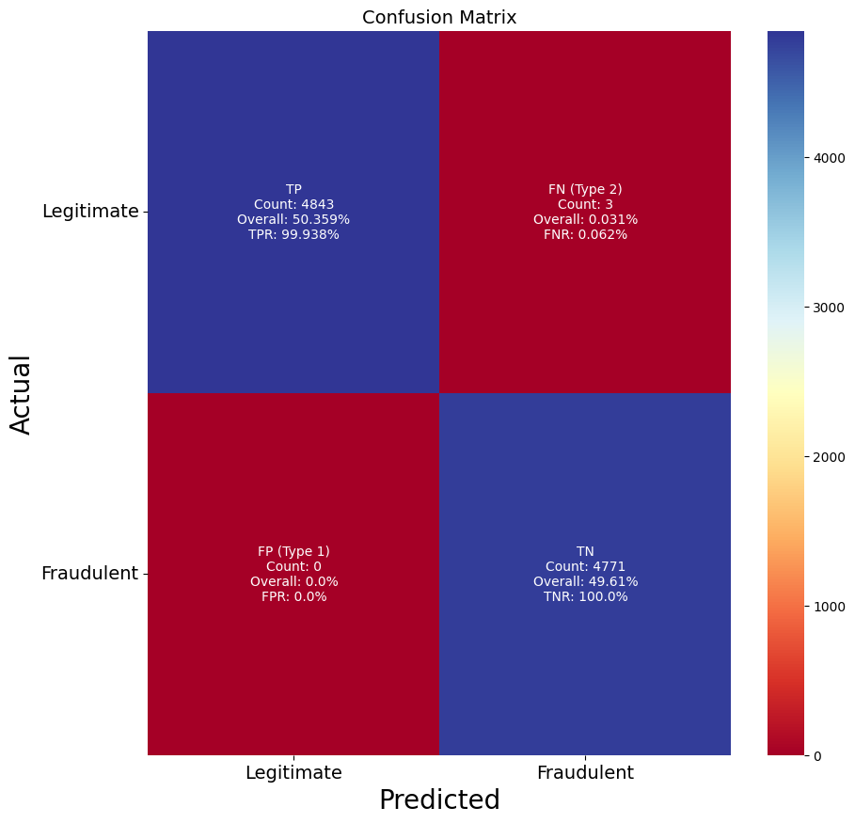
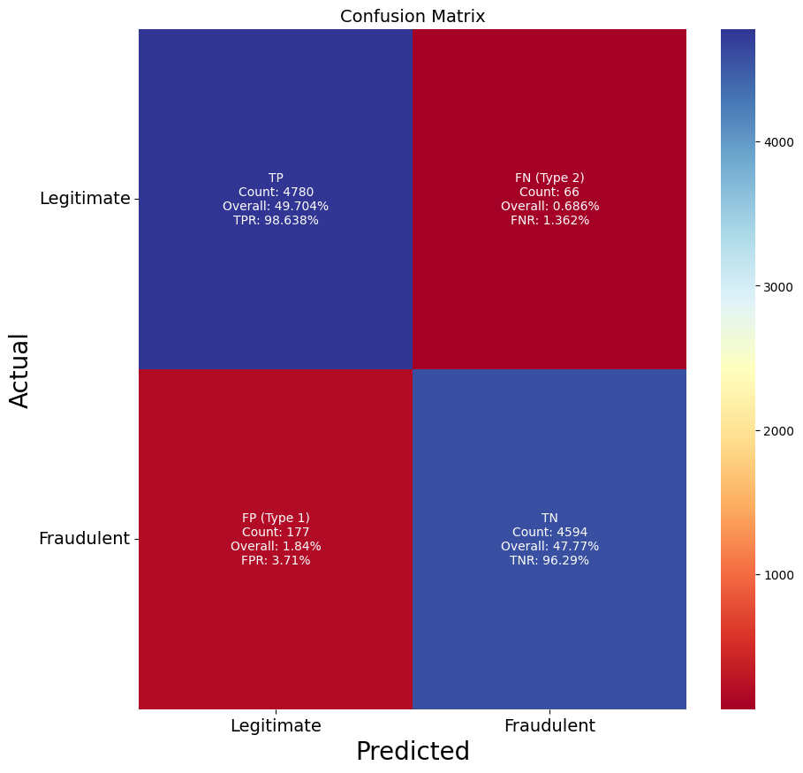
RESULT ANALYSIS
14
XGBClassifier:
The XGBClassifier proved highly effective in credit card fraud detection, boasting an impressive accuracy of 99.97%. Its ensemble nature, leveraging gradient boosting, enabled the model to handle intricate patterns in transaction data. Notably, XGBClassifier demonstrated perfect precision, recall, and F1-scores, showcasing its mastery in recognizing both regular and fraudulent transactions.
Logistic Regression:
Despite a slightly lower accuracy of 97.47%, Logistic Regression emerged as a reliable and interpretable option. Balancing simplicity and precision, it excelled in identifying regular transaction patterns. While precision decreased for fraudulent transactions, Logistic Regression remains valuable for applications where interpretability is paramount.

Slide 15

15
LightGBM:
LightGBM exhibited remarkable performance with an accuracy of 99.97%, coupled with efficiency in processing large-scale datasets. Its histogram-based tree construction method and ability to handle categorical features without one-hot encoding contributed to its speed and high accuracy. Perfect precision, recall, and F1-scores underscored LightGBM suitability for accurate and efficient credit card fraud detection.
KNN (K-Nearest Neighbor):
KNN demonstrated strength with an accuracy of 99.96%, showcasing its ability to identify patterns using similarity metrics. Its ease of use and flexibility in handling non-linear and irregular patterns make it an attractive option. However, potential computational expenses, especially with larger datasets, need consideration.

Slide 16
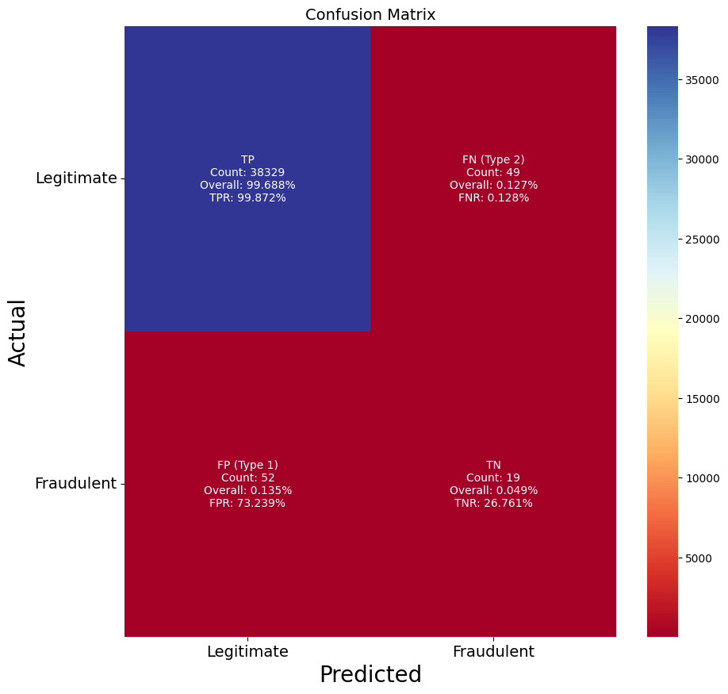
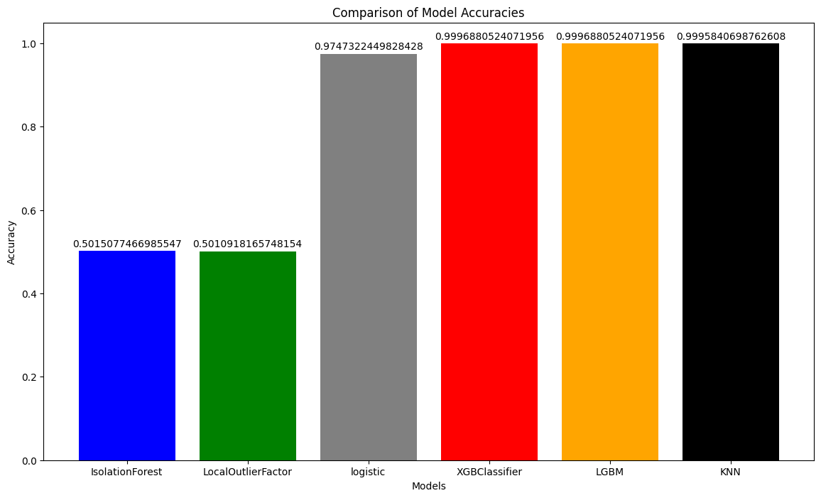
16
Local Outlier Factor (LOF) and Isolation Forest:
Despite attempts to rectify imbalance, LOF and Isolation Forest faced challenges, struggling to accurately detect and forecast fraudulent activity. The complexities in identifying subtle patterns linked to credit card fraud were evident, emphasizing the need for additional research and alternative modeling strategies.
Comparison of the accuracy:
In our credit card fraud detection evaluation, XGBoost and LightGBM excelled with accuracies of 99.97%, showcasing exceptional performance on large-scale datasets. K-Nearest Neighbors (KNN) demonstrated robustness at 99.96%, emphasizing effective pattern capture. Logistic Regression provided a reliable baseline at 97.47%, prioritizing interpretability. However, Isolation Forest and Local Outlier Factor (LOF) faced challenges, yielding lower accuracies of 50.15% and 50.11%, especially in detecting fraudulent transactions (class 1). These findings highlight the need for models that balance accuracy, interpretability, and efficiency in credit card fraud detection.

Slide 17
FUTURE WORKS
17
For future research endeavors in credit card fraud detection, delving into advanced ensemble methods, fine-tuning feature engineering techniques, and incorporating deep learning architectures such as autoencoders holds great potential for enhancing detection accuracy. Exploring temporal aspects, transaction sequences, and user behavior patterns could offer valuable insights into evolving fraud dynamics. Moreover, prioritizing model interpretability and explainability methods is paramount to build trust and facilitate real-world adoption. Developing transparent and interpretable models ensures stakeholders can comprehend decision-making processes, fostering confidence in the reliability of credit card fraud detection systems. This comprehensive approach contributes to the ongoing evolution of robust and effective fraud detection methodologies in the ever-changing landscape of financial security.

Slide 18
LIMITATIONS
18
Although the goal of our work is to improve methods for detecting credit card fraud, it is important to recognise some limitations.
Different datasets and real-world situations may have different levels of efficacy for the suggested models and optimisation techniques. Additional validation may be necessary before generalising the results to particular financial institutions or regions.
As fraud tendencies are changing, it might be difficult to completely capture evolving approaches in previous data. The study's inability to adjust to unanticipated fraud shifts may also stem from its dependence on historical records.
In contexts with limited resources, the computational demands of some deep learning architectures could make practical implementation difficult.
In order to stay up to date with changing industry standards and the introduction of new fraud paradigms, the performance measures and benchmarks set out in this work could require an occasional reevaluation.

Slide 19
CONCLUSION
19
In conclusion, our study delved into a comprehensive exploration of credit card fraud detection models, employing diverse machine learning algorithms. XGBoost, LightGBM, and K-Nearest Neighbors demonstrated commendable accuracy, showcasing their effectiveness in detecting complex fraud patterns. Logistic Regression provided a valuable baseline for understanding linear relationships in the data. However, Isolation Forest and Local Outlier Factor faced challenges in accurately identifying fraudulent transactions, emphasizing the need for careful model selection. Future research should delve into advanced ensemble methods, refined feature engineering, and deep learning architectures to further enhance credit card fraud detection. The study underscores the ongoing complexities of fraud detection tasks and the critical importance of balancing accuracy, interpretability, and computational efficiency in model selection. The incorporation of transparent and interpretable models in future work is essential to build trust and facilitate real-world adoption of fraud detection systems.

Slide 20
REFERENCES
20
[1] Ileberi, E., Sun, Y., & Wang, Z. (2022). A machine learning based credit card fraud detection using the GA algorithm for feature selection. Journal of Big Data, 9(1), 1-17.
[2] Jiang, S., Dong, R., Wang, J., & Xia, M. (2023). Credit Card Fraud Detection Based on Unsupervised Attentional Anomaly Detection Net work. Systems, 11(6), 305.
[3] Chung, J., & Lee, K. (2023). Credit Card Fraud Detection: An Improved Strategy for High Recall Using KNN, LDA, and Linear Regression. Sensors, 23(18), 7788.
[4] Alfaiz, N. S., & Fati, S. M. (2022). Enhanced credit card fraud detection model using machine learning. Electronics, 11(4), 662.
[5] Roseline, J. F., Naidu, G. B. S. R., Pandi, V. S., alias Rajasree, S. A., &Mageswari, N. (2022). Autonomous credit card fraud detection using machine learning approach. Computers and Electrical Engineering, 102, 108132..
[6] Almarshad, F. A., Gashgari, G. A., & Alzahrani, A. I. (2023). Generative Adversarial Networks-Based Novel Approach for Fraud Detection for the European Cardholders 2013 Dataset. IEEE Access.
[7] Journal, I. R. J. E. T. (2023). Credit Card Fraud Detection Using Machine Learning. IRJET.
[8] S, Varun. (2020). Credit Card Fraud Detection using Machine Learning Algorithms. International Journal of Engineering Research and. V9. 10.17577/IJERTV9IS070649.
[9] Journal, I. (n.d.). Credit Card Fraud Detection using Machine Learn ing.https://www.academia.edu/51587581/Credit Card Fraud Detection using Machine Learning

Slide 21

Thank you!
21

